Slide 1
OSI Reference Model
OSI Reference Model - internationally standardised network architecture.
OSI = Open Systems Interconnection: deals with open systems, i.e. systems open for communications with other systems.
Specified in ISO 7498.
Model has 7 layers.
Notes:
The OSI model describes the flow of data in a network, from the lowest layer (the physical connections) up to the layer containing the user’s applications. Data going to and from the network is passed layer to layer. Each layer is able to communicate with the layer immediately above it and the layer immediately below it. This way, each layer is written as an efficient, streamlined software component. When a layer receives a packet of information, it checks the destination address, and if its own address is not there, it passes the packet to the next layer.
When two computers communicate on a network, the software at each layer on one computer assumes it is communicating with the same layer on the other computer. For example, the Transport layer of one computer communicates with the Transport layer on the other computer. The Transport layer on the first computer has no regard for how the communication actually passes through the lower layers of the first computer, across the physical media, and then up through the lower layers of the second computer.

Slide 2
Layer 1: Physical Layer
Transmits bits from one computer to another
Regulates the transmission of a stream of bits over a physical medium.
Defines how the cable is attached to the network adapter and what transmission technique is used to send data over the cable. Deals with issues like
The definition of 0 and 1, e.g. how many volts represents a 1, and how long a bit lasts?
Whether the channel is simplex or duplex?
How many pins a connector has, and what the function of each pin is?
Notes:
The Physical Layer is concerned with the details of bit transmission over a physical channel.
Design issues for this layer include:
the definition of 0 and 1, e.g. how many volts represents a 1, and how long a bit lasts,
whether the channel is simplex or duplex,
how many pins a connector has, and what the function of each pin is.
More generally, design issues here deal with Mechanical, Electrical and Procedural matters.

Slide 3
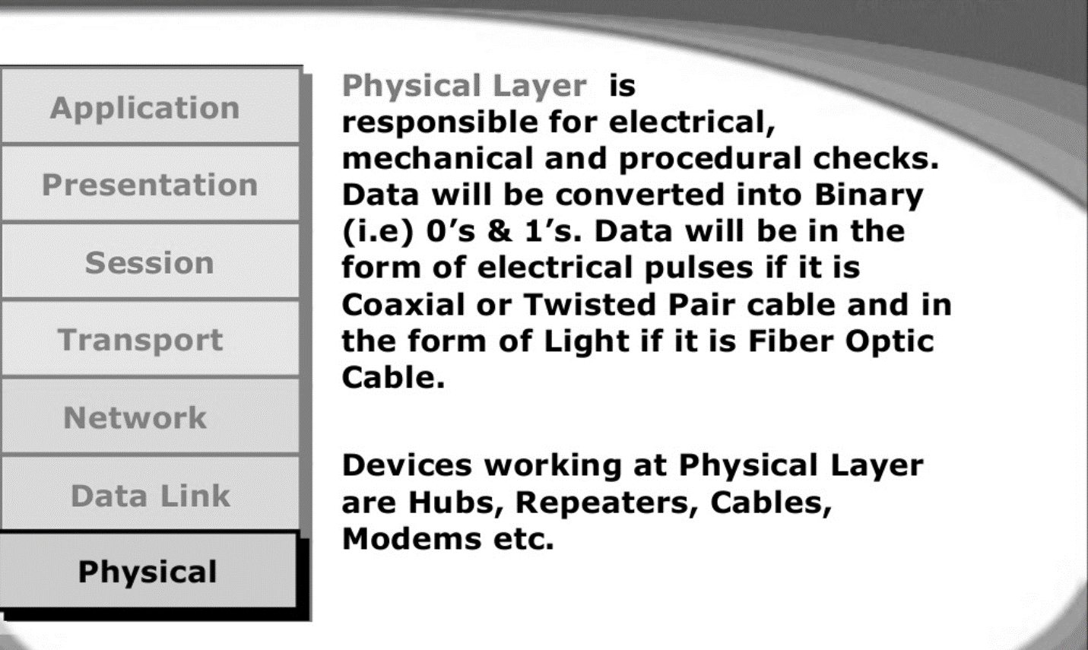

Slide 4
Physical Layer
Provides physical interface for transmission of information.
Defines rules by which bits are passed from one system to another on a physical communication medium.
Covers all - mechanical, electrical, functional and procedural - aspects for physical communication.
Such characteristics as voltage levels, timing of voltage changes, physical data rates, maximum transmission distances, physical connectors, and other similar attributes are defined by physical layer specifications.

Slide 5
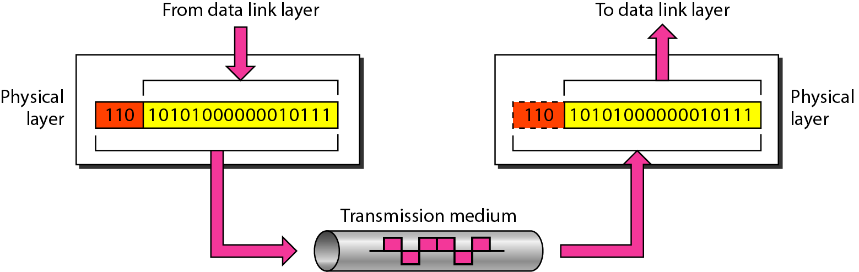
Physical layer

Slide 6

Note
The physical layer is responsible for movements of
individual bits from one hop (node) to the next.

Slide 7
Layer 2: Data Link Layer
Packages raw bits from the Physical layer into frames (logical, structured packets for data).
Provides reliable transmission of frames
It waits for an acknowledgment from the receiving computer.
Retransmits frames for which acknowledgement not received
Notes:
This layer takes the ‘raw’ transmission facility provided by the Physical Layer (Layer 1) and uses it to provide a reliable, error-free transmission service.
It does this by breaking the data stream up into frames, typically of thousands of bytes in length. Where necessary, special acknowledgement frames can be sent back by the receiving Data Link entity to indicate successful receipt of each frame.
The Physical Layer transmits a continuous sequence of bits, and so Layer 2 must create and recognise frame boundaries. This is typically done by the insertion of special bit patterns.
Channel errors can completely destroy a frame, and hence retransmission may be necessary. This, in turn, leads to the possibility of duplicate frames being received. Data Link protocols must deal with these problems.
A Data Link protocol may offer several different ‘service classes’ to the Network Layer, each with a different quality and cost.
The Data Link Layer must also regulate traffic flow to prevent ‘swamping’ of a slow receiver.
In a duplex channel there may be competition between data and acknowledgment frames; one solution is known as piggybacking, where acknowledgement information is attached to data frames.

Slide 8
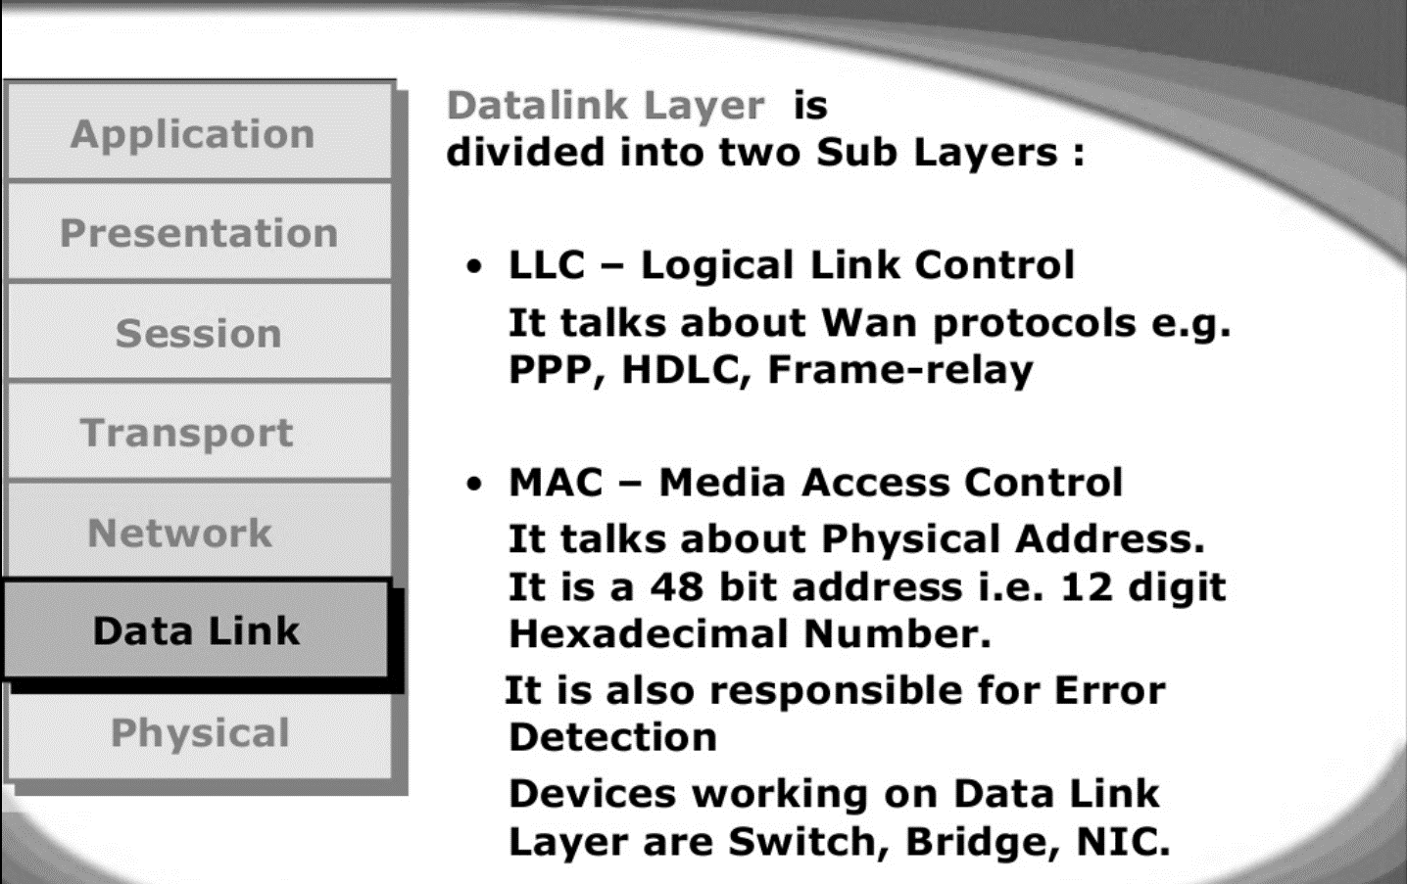

Slide 9
Data Link Layer
Data link layer attempts to provide reliable communication over the physical layer interface.
Breaks the outgoing data into frames and reassemble the received frames.
Create and detect frame boundaries.
Handle errors by implementing an acknowledgement and retransmission scheme.
Implement flow control.
Supports points-to-point as well as broadcast communication.
Supports simplex, half-duplex or full-duplex communication.

Slide 10
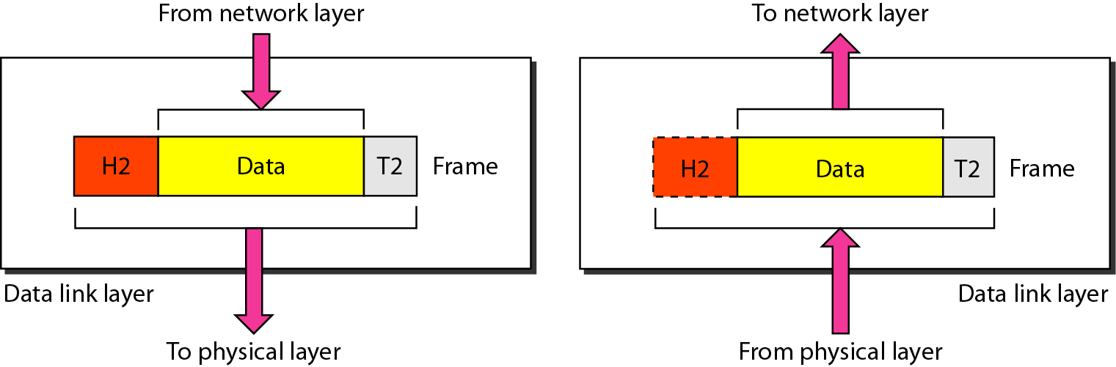
Data link layer

Slide 11
Note
The data link layer is responsible for moving frames from one hop (node) to the next.

Slide 12
Layer 3: Network Layer
Manages addressing/routing of data within the subnet
Addresses messages and translates logical addresses and names into physical addresses.
Determines the route from the source to the destination computer
Manages traffic problems, such as switching, routing, and controlling the congestion of data packets.
Routing can be:
Based on static tables
determined at start of each session
Individually determined for each packet, reflecting the current network load.
Notes:
The Network Layer controls the subnet.
The key design issue is routing of data within the subnet. Routing can be:
based on static tables (rarely changed),
determined at the start of each session, or
highly dynamic: individually determined for each packet, reflecting the current network load.
Too many packets in the subnet simultaneously can form bottlenecks; this is dealt with by congestion control procedures in the Network Layer.
Accounting for subnet use is also typically the responsibility of the Network Layer.
When a packet travels from one network to another, address conversion may be necessary; this is also performed by the Network Layer.
In Broadcast networks (e.g. many LANs), the routing problem is very straightforward, and hence Layer 3 will be very simple, or even non-existent.

Slide 13
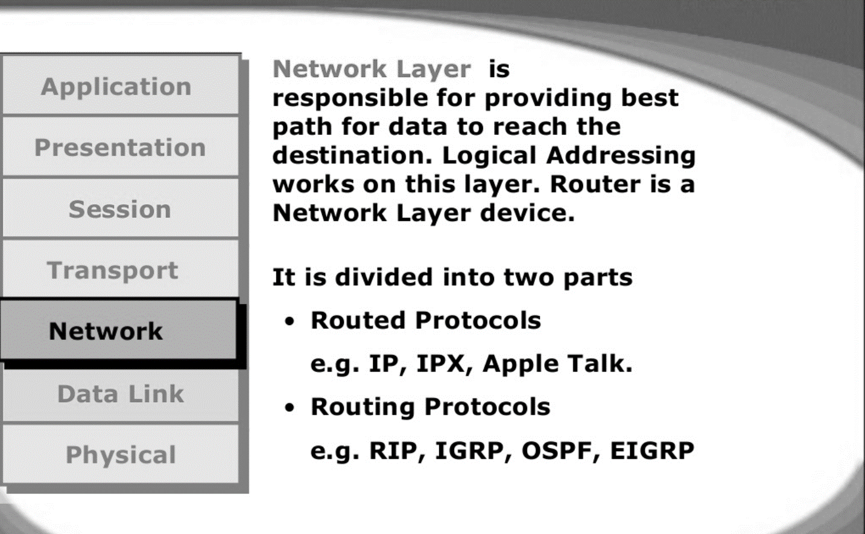

Slide 14
Network Layer
OSI Model
Implements routing of frames (packets) through the network.
Defines the most optimum path the packet should take from the source to the destination
Defines logical addressing so that any endpoint can be identified.
Handles congestion in the network.
Facilitates interconnection between heterogeneous networks (Internetworking).
The network layer also defines how to fragment a packet into smaller packets to accommodate different media.

Slide 15
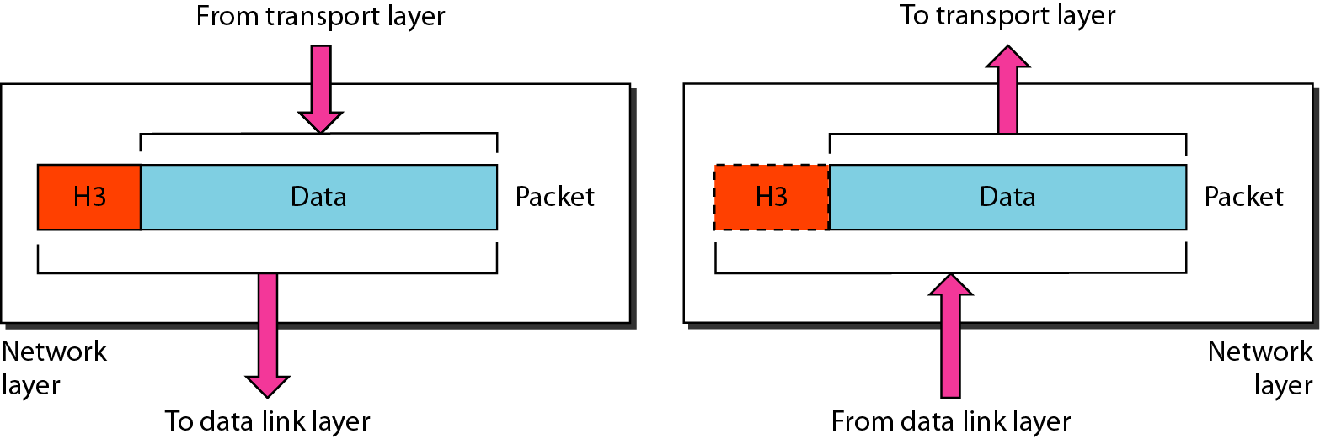
Network layer

Slide 16
Note
The network layer is responsible for the delivery of individual packets from
the source host to the destination host.

Slide 17
Layer 4: Transport Layer
Manages transmission packets
Repackages long messages when necessary into small packets for transmission
Reassembles packets in correct order to get the original message.
Handles error recognition and recovery.
Transport layer at receiving acknowledges packet delivery.
Resends missing packets
Notes:
The basic function of the Transport Layer is to take data from the Session Layer (Layer 5), split it up into smaller units (as necessary), and pass these units on to the Network Layer. It is then also responsible for ensuring that all the pieces are received correctly and reassembled in the correct order.
Typically the Transport Layer will create a distinct Network Layer connection for each Transport connection requested by the Session Layer. However, depending on the data load and the capacity of a single Session channel:
multiple Network connections might be used to support a single high-bandwidth Session connection, or
one high-bandwidth Network connection might be used to support several Session connections.
The Transport Layer also determines what Type of Service to provide to the Session Layer and, ultimately, to the network users. For example:
an error-free, point-to-point channel, guaranteeing data is delivered in the correct order (the most common type of service),
transport of isolated messages with no guarantee of correct ordering, or
message broadcast to multiple destinations
Transport is the first true end-to-end layer, i.e. the Transport protocol communicates between end parties and not to any of the intermediaries.

Slide 18
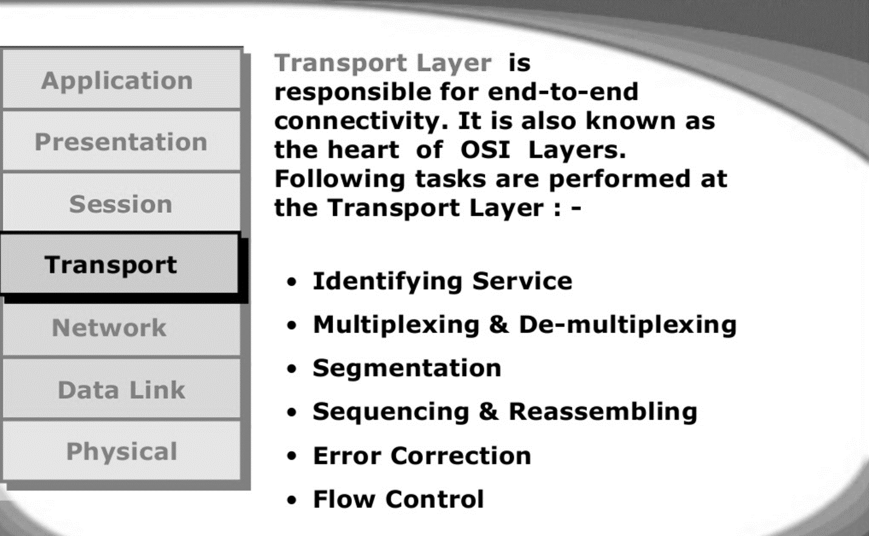

Slide 19
Transport Layer
OSI Model
Purpose of this layer is to provide a reliable mechanism for the exchange of data between two processes in different computers.
Ensures that the data units are delivered error free.
Ensures that data units are delivered in sequence.
Ensures that there is no loss or duplication of data units.
Provides connectionless or connection oriented service.
Provides for the connection management.
Multiplex multiple connection over a single channel.

Slide 20
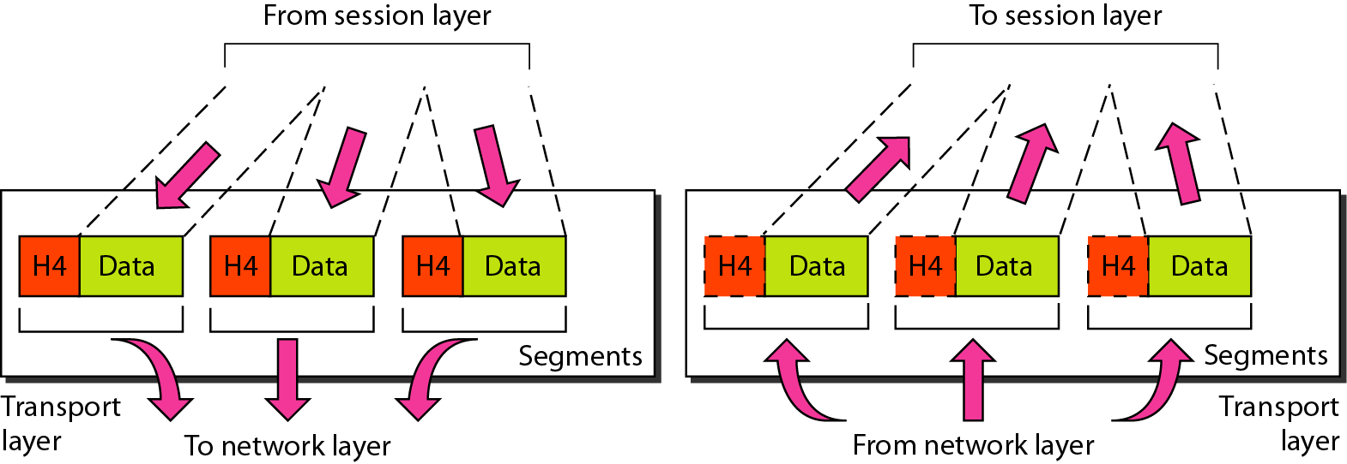
Transport layer

Slide 21
Note
The transport layer is responsible for the delivery of a message from one process to another.

Slide 22
Layer 5: Session Layer
Allows two applications on different computers to establish, use, and end a session.
e.g. file transfer, remote login
Establishes dialog control
Regulates which side transmits, plus when and how long it transmits.
Performs token management and synchronization.
Notes:
The Session Layer allows the establishment of sessions between machines, e.g. to allow remote logins to a multi-user system, or to perform file transfer between machines.
One of the Session services is dialogue control; if the communications are half-duplex then the session layer can manage which entity sends when.
A related service is token management. In some protocols it is essential that both entities do not attempt the same operation simultaneously. Possession of a token permits the operation.
The other main Session service is synchronization. As an example consider attempting a 2-hour file transfer between machines which crash on average once an hour. The synchronization service provides a means for checkpoints to be inserted into the data stream so that, after a crash, only data sent since the last checkpoint needs to be re-transmitted.

Slide 23
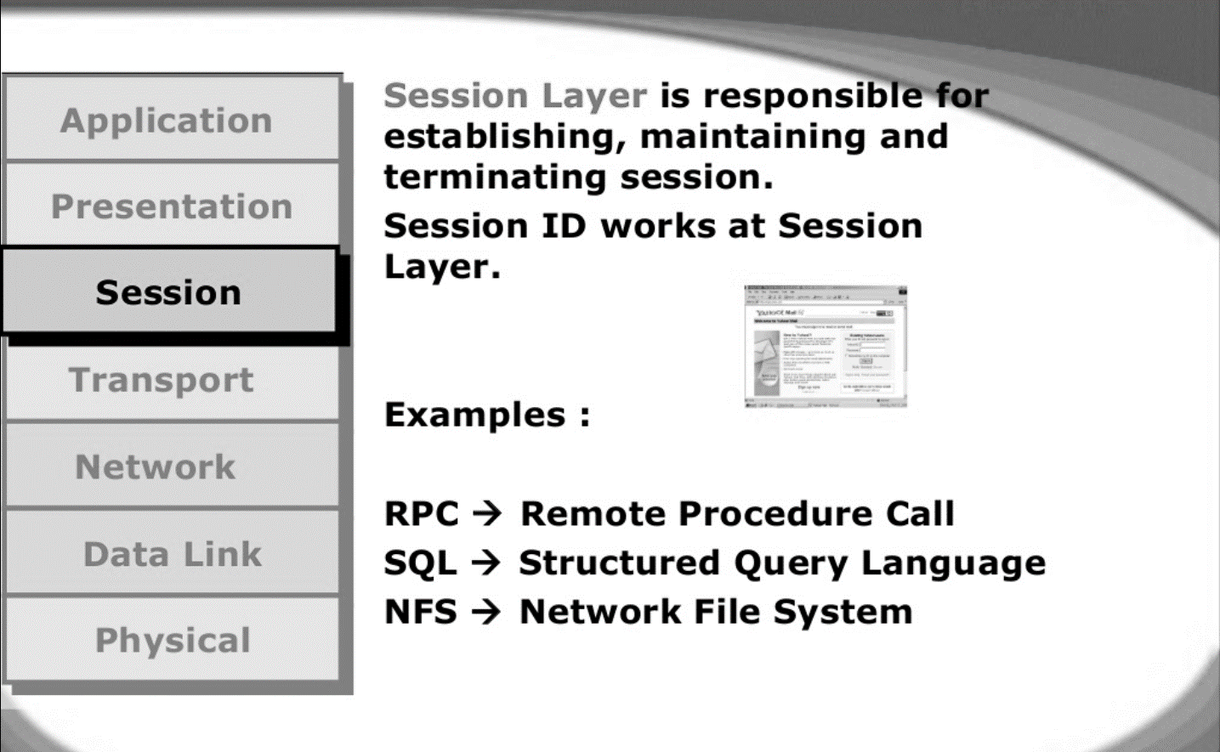

Slide 24
Session Layer
Session layer provides mechanism for controlling the dialogue between the two end systems. It defines how to start, control and end conversations (called sessions) between applications.
This layer requests for a logical connection to be established on an end-user’s request.
Any necessary log-on or password validation is also handled by this layer.
Session layer is also responsible for terminating the connection.
This layer provides services like dialogue discipline which can be full duplex or half duplex.
Session layer can also provide check-pointing mechanism such that if a failure of some sort occurs between checkpoints, all data can be retransmitted from the last checkpoint.

Slide 25
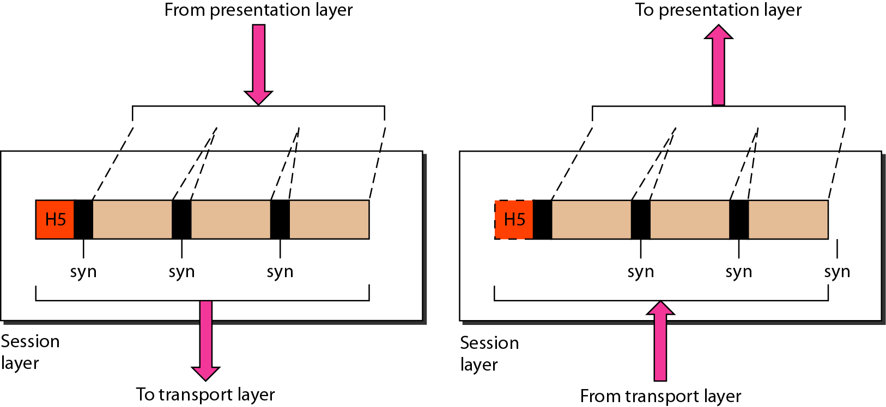
Session layer

Slide 26
Note
The session layer is responsible for dialog control and synchronization.

Slide 27
Layer 6: Presentation Layer
Related to representation of transmitted data
Translates different data representations from the Application layer into uniform standard format
Providing services for secure efficient data transmission
e.g. data encryption, and data compression.
Notes:
The Presentation Layer is concerned with the representation of data to be transmitted, e.g. providing a standard encoding for data.
Different computers often use different representations for data structures such as characters (ASCII or EBCDIC), integers (one’s complement or two’s complement, and varying byte ordering conventions), and floating point values (IEEE or proprietary).
The Presentation Layer provides a standard encoding technique (using ASN.1 - Abstract Syntax Notation 1).
The Presentation Layer is also concerned with other representation issues such as data compression and encryption of data.
In terms of the usual communications model, the Presentation Layer is responsible for source coding of data.

Slide 28
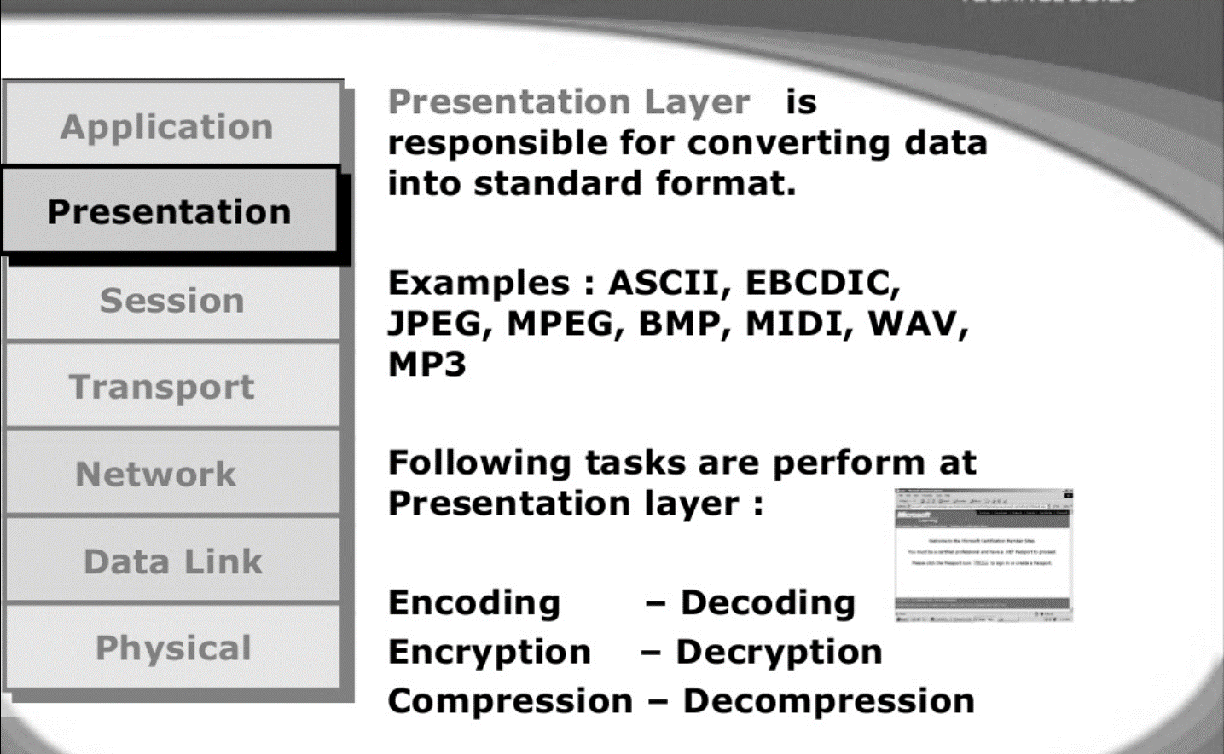

Slide 29
Presentation Layer
OSI Model
Presentation layer defines the format in which the data is to be exchanged between the two communicating entities.
Also handles data compression and data encryption (cryptography).

Slide 30
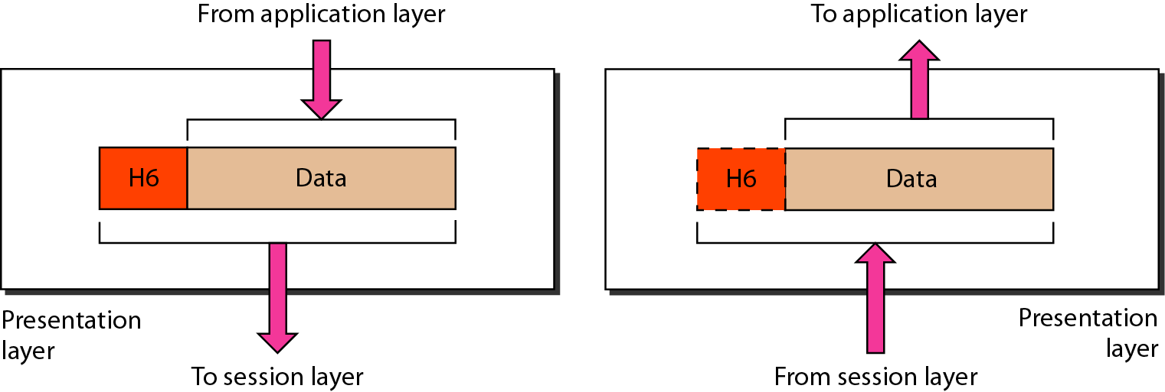
Presentation layer

Slide 31
Note
The presentation layer is responsible for translation, compression, and encryption.

Slide 32
Layer 7: Application Layer
Level at which applications access network services.
Represents services that directly support software applications for file transfers, database access, and electronic mail etc.
Notes:
The Application Layer is home to a wide variety of protocols to meet specific user needs.
Network virtual terminal. Used by ‘networked screen editors’ and other networked applications needing to handle many different terminal types. Software exists to map the functions of the virtual terminal onto the real terminal, e.g. cursor movement. Examples include OSI VTP and Internet telnet.
File transfer. Different file systems have different file naming conventions and internal record structures. Such a protocol must convert files to a ‘standard’ representation. Examples include OSI FTAM and Internet ftp.
Electronic mail. Examples of electronic mail protocols are OSI X.400 and Internet mail.
Directory service. Examples include OSI X.500.

Slide 33
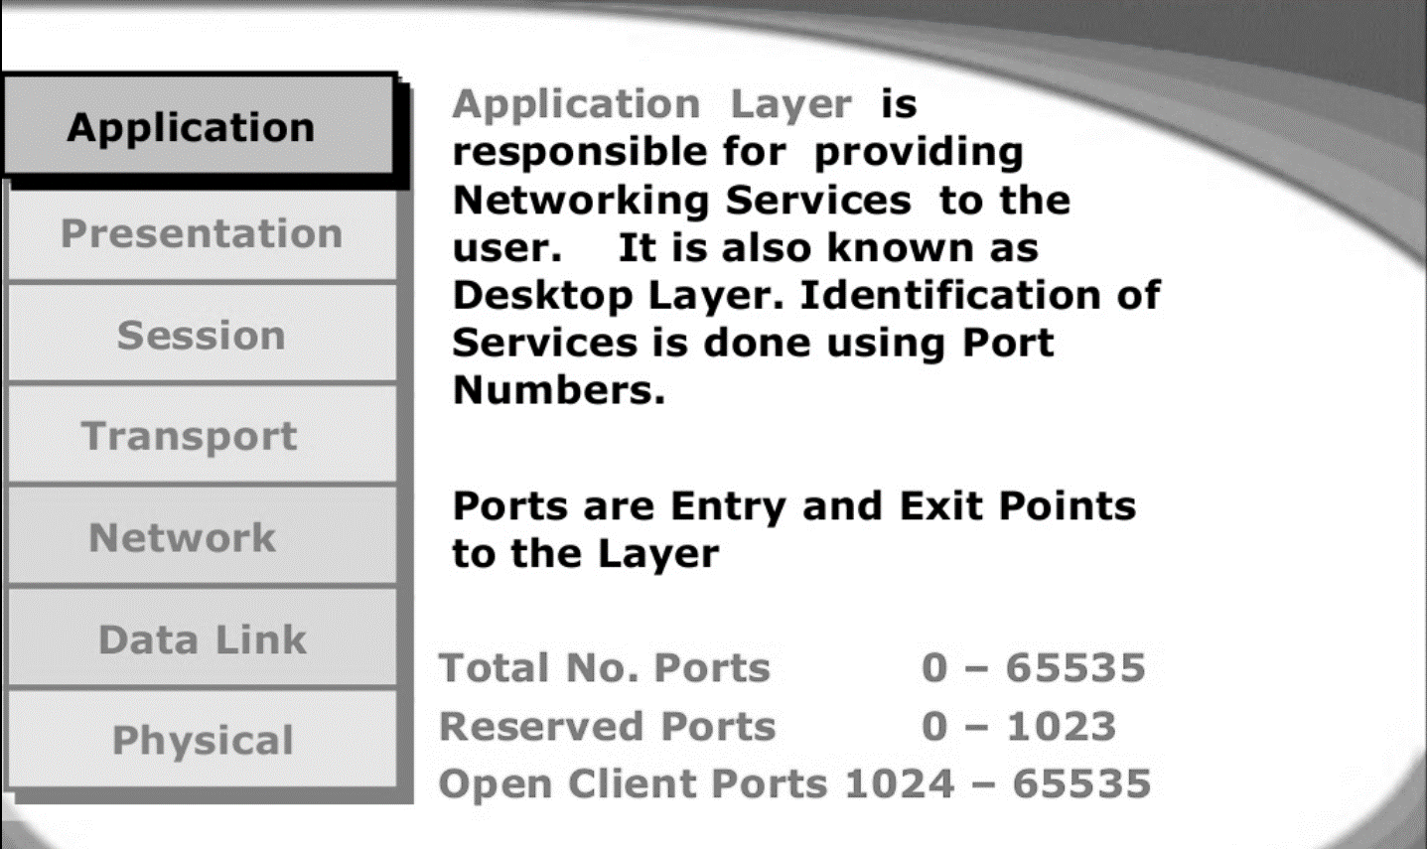

Slide 34
Application Layer
OSI Model
Application layer interacts with application programs and is the highest level of OSI model.
Application layer contains management functions to support distributed applications.
Examples of application layer are applications such as file transfer, electronic mail, remote login etc.

Slide 35
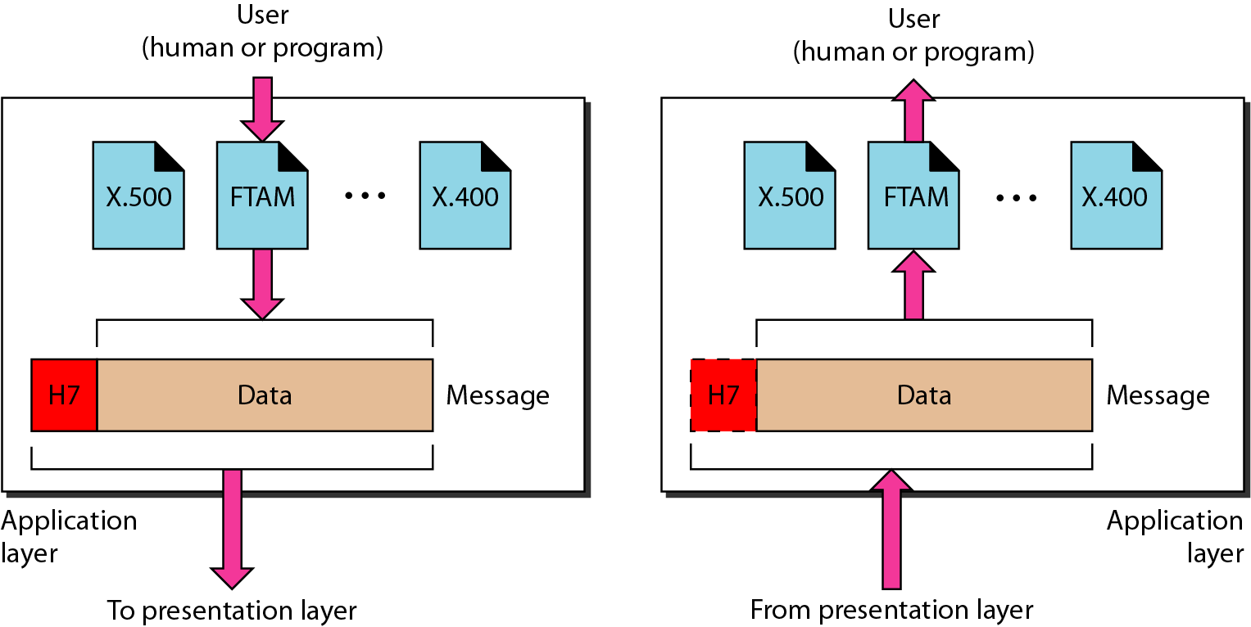
Application layer

Slide 36
Note
The application layer is responsible for providing services to the user.

Slide 37
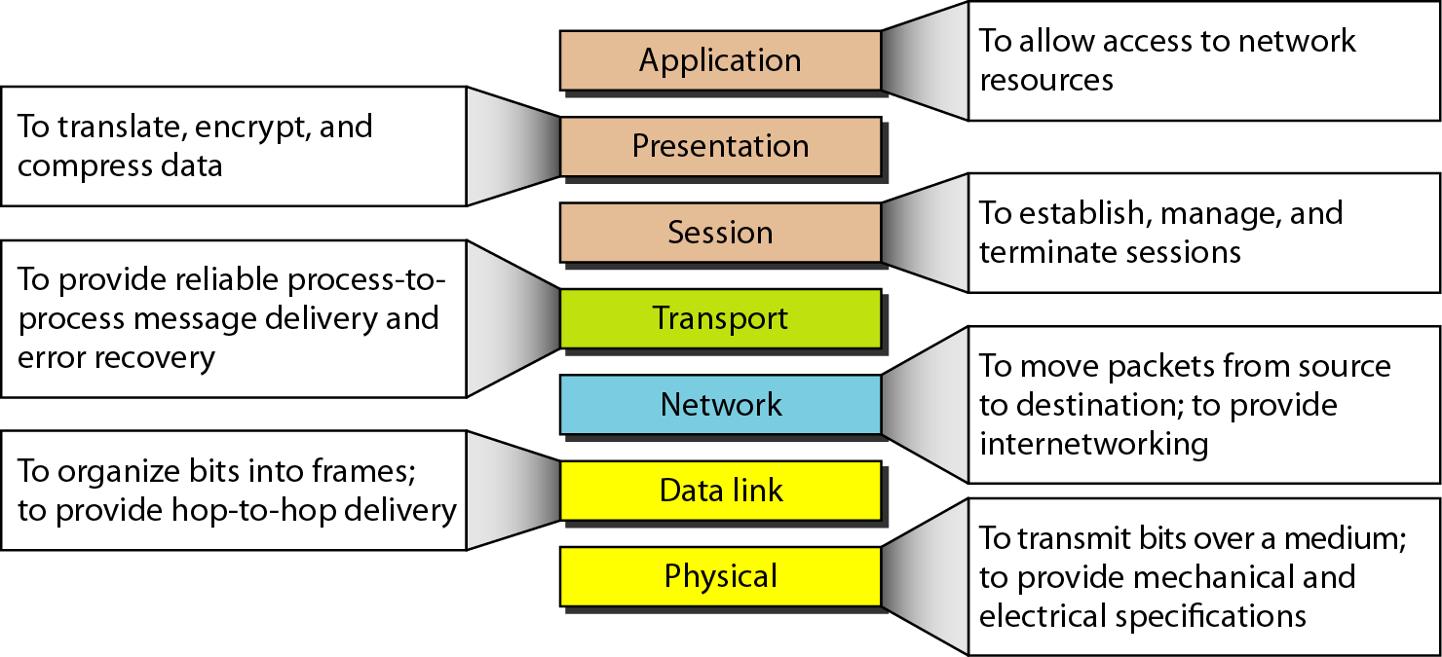
Summary of layers

Slide 38
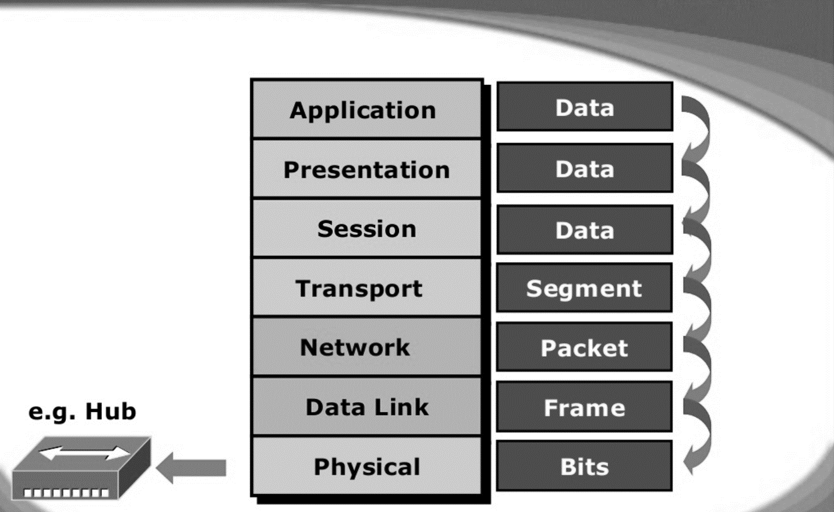

Slide 39
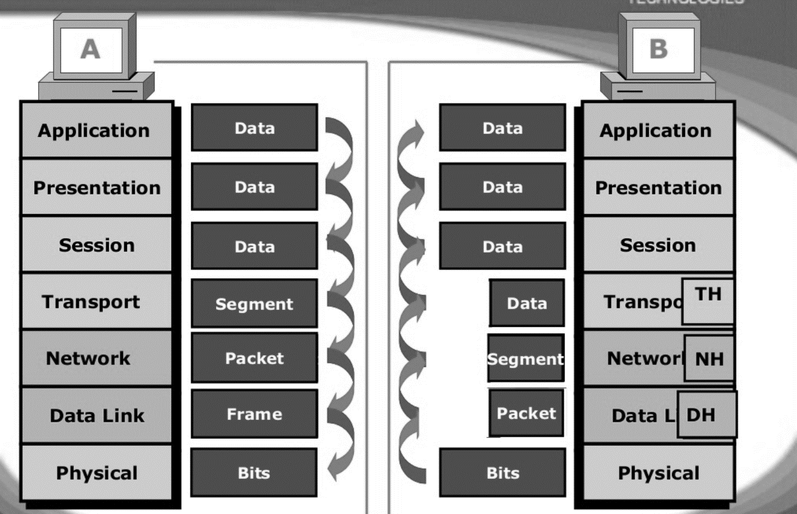

Slide 40
7-Layer OSI Model
Layer 7
Application Layer
Layers 1-4 relate to communications technology.
Layers 5-7 relate to user applications.
Layer 6
Presentation Layer
Layer 5
Session Layer
Layer 4
Transport Layer
Layer 3
Network Layer
Layer 2
Data Link Layer
Layer 1
Physical Layer
Communications subnet boundary
Notes:
The Application layer represents the level at which applications access network services. This layer represents the services that directly support applications such as software for file transfers, database access, and electronic mail.
• The Presentation layer translates data from the Application layer into an intermediary format. This layer also manages security issues by providing services such as data encryption, and compresses data so that fewer bits need to be transferred on the network.
• The Session layer allows two applications on different computers to establish, use, and end a session. This layer establishes dialog control between the two computers in a session, regulating which side transmits, plus when and how long it transmits.
• The Transport layer handles error recognition and recovery. It also repackages long messages when necessary into small packets for transmission and, at the receiving end, rebuilds packets into the original message. The receiving Transport layer also sends receipt acknowledgments.
• The Network layer addresses messages and translates logical addresses and names into physical addresses. It also determines the route from the source to the destination computer and manages traffic problems, such as switching, routing, and controlling the congestion of data packets.
• The Data Link layer packages raw bits from the Physical layer into frames (logical, structured packets for data). This layer is responsible for transferring frames from one computer to another, without errors. After sending a frame, it waits for an acknowledgment from the receiving computer.
• The Physical layer transmits bits from one computer to another and regulates the transmission of a stream of bits over a physical medium. This layer defines how the cable is attached to the network adapter and what transmission technique is used to send data over the cable
This partition into ‘lower’ and ‘upper’ layers is a widely used way to distinguish between the communications-oriented layers and the applications- oriented layers.
In fact layers 5 and 6 are often ignored in practical applications (the Internet protocol hierarchy has no equivalents to layers 5 and 6).

Slide 41
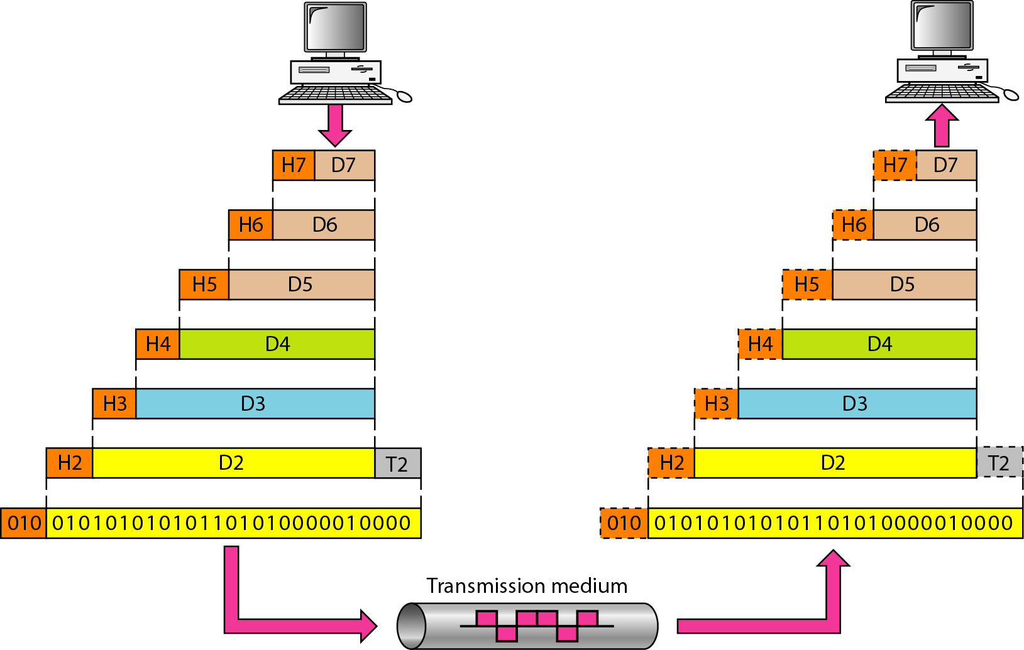
An exchange using the OSI model

Slide 42
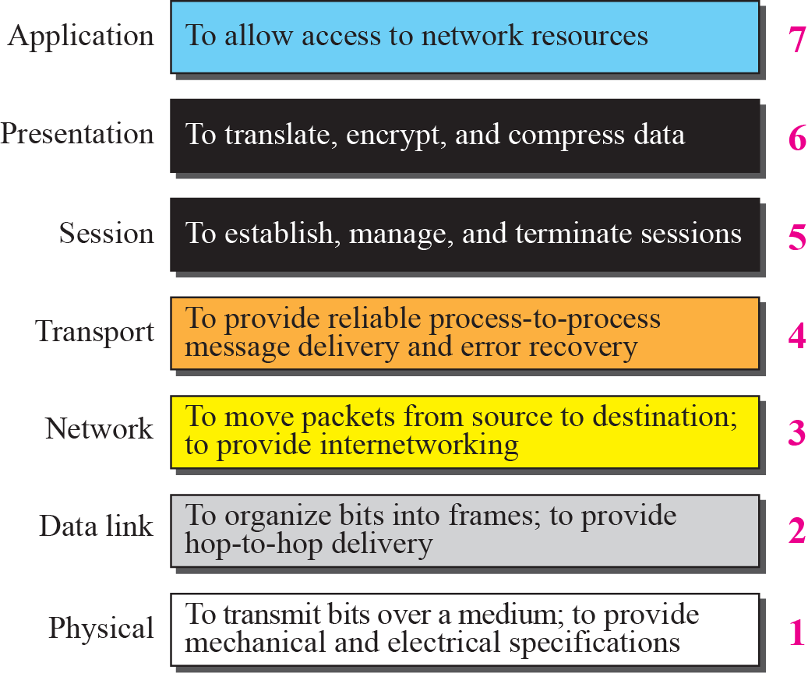
Summary of OSI Layers

